Slide 1
Agile Presentation
Southern New Hampshire University
CS-250 Software Development Lifecycle
Winnie Kwong
Professor Morrison
June 17th, 2023

Slide 2

Agenda
Scrum-Agile Approach
Scrum-Agile Team
Phases of the SDLC
Waterfall Development Approach
Waterfall vs. Agile
Choosing the Right Methodology

Slide 3
Scrum-Agile Approach
The Scrum-Agile methodology is the project management system that depends on sprints to collaborate and provide feedback on work in progress. According to Peek, “Scrum is a type of agile technology that consists of meetings, roles, and tools to help teams working on complex projects collaborate and better structure and manage their workload.” (Peek, 2023, para 10).

Slide 4
Scrum-Agile Team Roles
Product Owner
Scrum Master
Developer
Tester
Responsible for maximizing the value of the product and the work of the development team
Accountable for effective Product Backlog management
Ensuring that the Product Backlog is transparent, visible and understood. (Scrum Guide | Scrum Guides, n.d., para 24)
Represents business sponsor, decision making, direction for the team, and prioritizes development team’s work
Ensures Scrum theory, practices, and rules are understood within the development team and organization
Coaches the team in self-management and cross-functionality
Serves Product Owner by finding effective techniques for Product Backlog management
Facilitates all Scrum Events
Creates the software for the project
Completes duties in the given time frame
Document work for future review and use
Collaborate with other developers, programmers, business analysts, and project managers
Measuring and reporting all tests related to the project
Works with the Product Owner to define acceptance criteria and “done”
Actively collaborating with developers and business stakeholders to clarify requirements, especially in terms of testability, consistency, and completeness (Ghahrai, n.d., para 4)

Slide 5
Stages of the Agile Software Development Life Cycle (SDLC)
Concept
01
Planning
02
Building
03
Testing
04
Deployment
05
Retirement
06

Slide 6
Various Phases of the SDLC Work in an Agile Approach
Concept
Planning
Building
The planning stage, where the primary goal is to scope and prioritize projects
All relevant documents are collected to develop a product based on the customer’s expectations.
Determines what are the resource plan, schedule, and budgets of the project
The purpose is to analyze problems and determine the features of the product
Diagram requirements for the initial sprint
Designing specifications for developers to utilize
Assigning tasks and resources to prepare to build the product
The development team begins to construct the code
All components from previous phases are implemented into the source code
Developers must track and document any adjustments to the code’s construction.

Slide 7
Various Phases of the SDLC Work in an Agile Approach (continue)
Testing
Deployment
Retirement
Testers ensure application works and is ready to release the iteration into production
Testers will test the functionality to ensure quality and reliability of the product
Testers will detect bugs and fix any errors in the code to meet user expectations
All test cases must log all results regardless of pass or fail
Production and ongoing support for the software release
All known errors must be eliminated at the final testing and verification before deployment
The product must meet all the customer’s requirements
The purpose is to remove a system from the production environment
Either it is being replaced with new software, or the system itself has become obsolete or incompatible with the organization over time (Wrike, 2022, para 12)
System is decommissioned and data is archived

Slide 8
Ways to Manage SDLC – Scrum Events in each Sprint
Sprint Planning
Daily Scrum
Sprint Review
Sprint Retrospective
The purpose is to define what can be delivered in the sprint and how it can be achieved
Involves the entire Scrum team: Scrum Master, Product Owner, and Development team
Breaking down user stories into tasks (particularly testing tasks) (Ghahrai, n.d., para 13)
Time-boxing: expanding the size of the schedule interval to accommodate the size of whatever task is being performed. (Cobb, 2015, p. 90)
Development teams meet for no more than 15 minutes every day to inspect and adapt the product and process daily
Check-In Reports example: 1) What was accomplished yesterday? 2) What was accomplished today? 3) What obstacles are in the way
The development team represents the final work for review and approval
Brief User Acceptance Test at the end of each sprint
All defects should be resolved before sprint review unless approved by Product Owner
Best practice is to invite customers and stakeholders to give feedback
The primary purpose is to reflect on what went well and what did not and identifies opportunities for improvement in the next sprint
Occurs at the end of each sprint that allows the team to have continuous improvement to adapt the process of each sprint

Slide 9
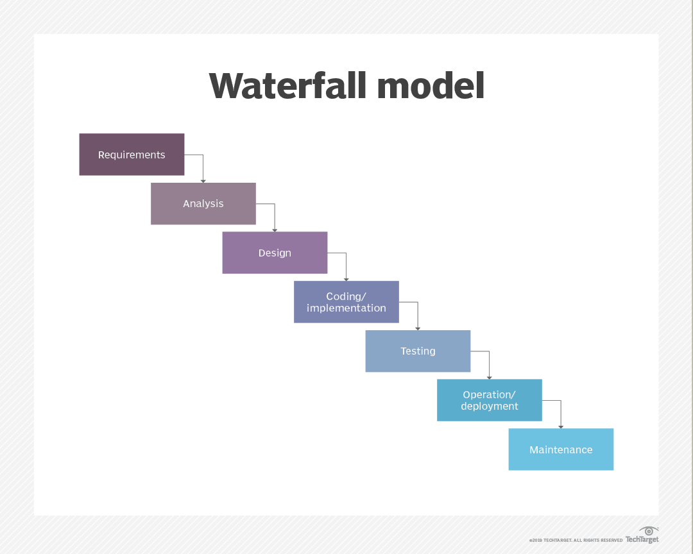
What is the Waterfall Approach?
Established by Winston W. Royce in 1970
Waterfall is ideal for projects like software development, where the end result is clearly established before starting, and is best suited for projects that require a lot of predictability. (Hoory & Bottorff, 2021, para 2)
Outlines the concept of breaking large projects into minor sequential phases for efficient management.
Each phase must be completed before advancing to the next step

Slide 10
What if the Project was Waterfall Instead of Agile Approach?
Lacks utilizing customer involvement Example: The team could not obtain feedback from clients and Product Owner to determine the user stories.
The project would focus on sequential phases instead of iterative nature
Requires consistent documentation at every step to make it easier to backtrack
Lack of ability to change Example: Using the Waterfall approach during the shift of the SNHU Travel plan, the team would have re-work their entire process, which would cause a lot of money and resources.
The team would have used the Gantt chart to work around deadlines and properly allocate resources.

Slide 11
Waterfall vs. Agile
Waterfall
Agile
Pros
Enables organizations to do extensive, upfront estimation and planning
Workflow is more structured because each phase requires a deliverable to proceed
Best for small projects where the requirements are easy to define
Cons
Lack of customer involvement
Overwhelming amount of upfront documentation
Difficult to make changes in previous phases
Testing only occurs after development phase (risk of more bugs)
Errors cannot be determined until the very end of the project, wasting valuable time and can be very expensive
Pros
Enables teams to rapidly respond to changing requirements (flexibility)
Supports tight deadlines that encourage productivity and efficiency
Clients do not need to wait for the results to see the project (helps get better understanding of client’s needs)
Entire process is transparent for stakeholders & team
Cons
Difficult to determine if the team is on the same page because deliverables are not a requirement to proceed to the next phase
Difficult to estimate delivery timelines
Requires team to understand Agile concepts that involve a lot of commitment and discipline

Slide 12
Factors to Consider When Choosing Waterfall or Agile Approach
Does the project have a well-defined end goal?
Can force the team to make a lot of assumptions to resolve uncertainty.
Assumptions can be wrong and require a lot of revising
Waterfall approach will need more re-work compared to the Agile approach
Waterfall is best for projects with concrete timelines and well-defined deliverables
How involved will the project owners, stakeholders, or customers be in the project?
Sometimes, the customer does not know what they want.
Example: SNHU Travel Project shifted from “Top 5 Travel Destinations” to “Top 5 Detox/Wellness Destinations”.
Agile approach can adapt to change in dynamics better than the Waterfall approach
Waterfall does not include collaboration with clients and shareholders, while Agile encourages it
Is documentation more important than the working software?
The rigid structure of the Waterfall Model makes documentation more comprehensive compared to Agile
Agile teams focus primarily on moving the product forward
“Working software over comprehensive documentation” (Agile Alliance, 2018)

Slide 13



References
Agile Alliance. (2018, December 12). Agile Manifesto for Software Development | Agile Alliance. Agile Alliance; Agile Alliance. https://www.agilealliance.org/agile101/the-agile-manifesto/
Charles G. Cobb. (2015). The Project Manager’s Guide to Mastering Agile : Principles and Practices for an Adaptive Approach. Wiley.
DeClute, D. (2022). Waterfall Model Image [TechTarget Waterfall Model Image]. In TheServerSide. https://www.theserverside.com/tip/Agile-vs-Waterfall-Whats-the-difference
Ghahrai, A. (n.d.). Agile Testing Mindset and the Role of the Agile Tester. Devqa.io. https://devqa.io/agile-testing-mindset-tester-role-agile-team/
Hoory, L., & Bottorff, C. (2021, October 26). What Is Waterfall Methodology And How Do I Use It? Forbes Advisor. https://www.forbes.com/advisor/business/what-is-waterfall-methodology/
Lucid Content Team. (2017, December). The Stages of the Agile Software Development Life Cycle. Lucidchart.com. https://www.lucidchart.com/blog/agile-software-development-life-cycle
Peek, S. (2023, February 22). What Is Agile Scrum Methodology? Business News Daily. https://www.businessnewsdaily.com/4987-what-is-agile-scrum-methodology.html
Scrum Guide | Scrum Guides. (n.d.). Scrumguides.org. https://scrumguides.org/scrum-guide.html#developer
Wrike. (2022). The Agile Software Development Life Cycle | Wrike Agile Guide. Wrike. https://www.wrike.com/agile-guide/agile-development-life-cycle/

Slide 14
Thank you
Winnie Kwong

